Slide 1
HTML5, CSS & JavaScript
Adrian Streitz, Johannes Rank, Borys Levkovskyi

Slide 2
Prerequisites
Fundamental programming skills
Successful completion of the chapter Introduction to SAP Application Development

Slide 3
Agenda
HTML5
CSS
JavaScript & jQuery
Examples

Slide 4
I. HTML5 Fundamentals
HTML5 = Hypertext Markup Language, Version 5
No programming language, but a markup language
Main purpose: Structuring and formatting of content (e.g. texts, pictures, hyperlinks)
Mainly used for the representation of web documents and web content
HTML pages are individually rendered by the browser
HTML5 provides new functionalities compared with HTML4, e.g.
New elements for mobile web pages
Integration of video and audio contents
New graphical elements

Slide 5



I. HTML5 Basic structure
Document type declaration
Header section: declaration of meta information, page title or links to Java Script or CSS files
Body: contains the content of the page
Each HTML page is enclosed by the <html>-tags
Character encoding for the browser
Title of the page
Document content, represented by an opening tag, the actual content, and a closing tag

Slide 6
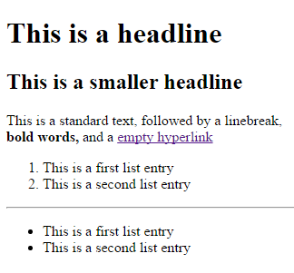
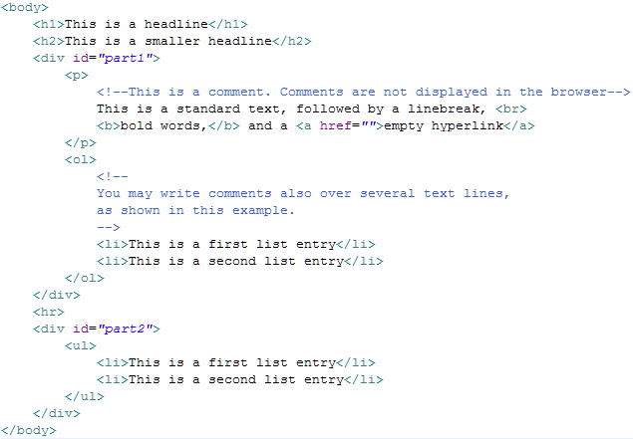
I. HTML5 Text elements and comments
HTML5 offers a huge variety of text elements to structure text content
Comments are written in between <!– and --> (also when used over several lines)

Slide 7
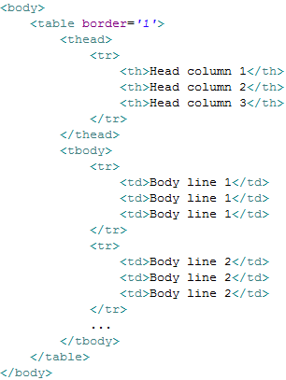
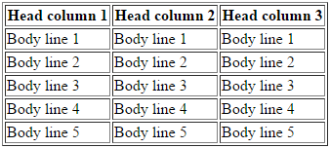
I. HTML5 Tables
Tables are an important element of HTML5 to show a higher amount of data within one view
It is separated between header data and body data

Slide 8
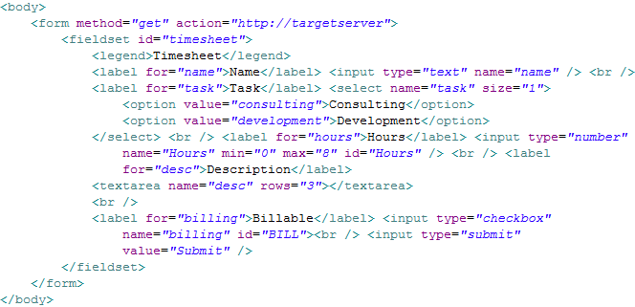
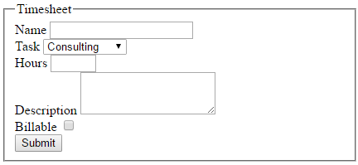
I. HTML5 Forms
Forms are used for interaction with the user
Typical forms are input screens, which can be processed e.g. with JavaScript

Slide 9
Now you know the fundamentals of HTML5.
To consolidate your knowledge, you can do task 1 and 2 of the HTML5, CSS & JavaScript exercise.

Slide 10

II. CSS Fundamentals
CSS = Cascading Style Sheets
CSS is used to format the content structured by HTML
Designing and positioning of the elements
CSS contains information about the position, the size and type of the text, background color, etc.
Syntax consists of selector and declaration
Selector
Declaration
Attribute
Value

Slide 11
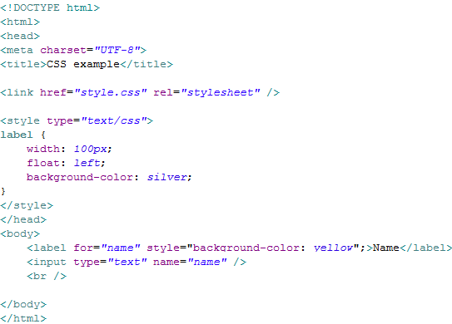
II. CSS Integrating CSS into HTML
There are three possibilities to integrate CSS into HTML
Style definitions are evaluated in a hierarchical order
1. Separate File
2. Direct declaration in header section
3. Inline declaration

Slide 12
II. CSS Selectors
With the selector you define the HTML elements for which the format definition is valid for:
Universal selector: valid for all elements
Type selector: valid for specific elements
ID selector: valid for all elements with the respective ID
Class selector: valid for all elements with the respective class attribute
Descendant selector: valid for elements if they are part of a specific other element

Slide 13
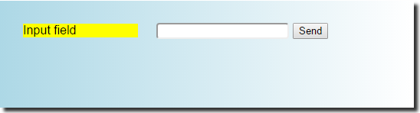
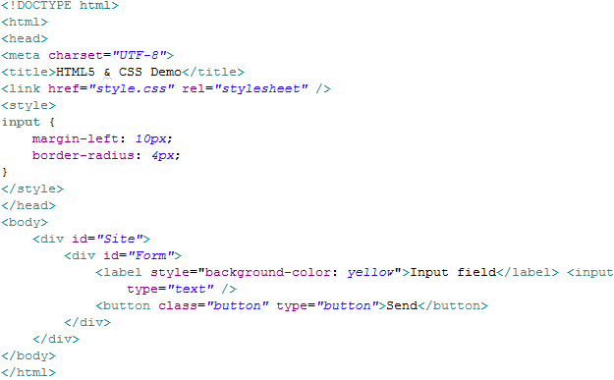
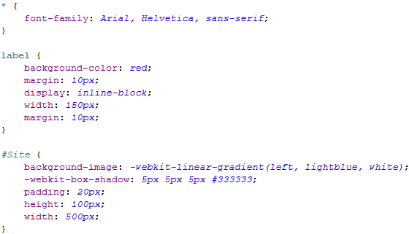
II. CSS HTML5 and CSS combined
Valid for all elements
Valid for all input fields
Overwrites style definition from label
Valid for all labels
Valid for all elements with ID “Site”

Slide 14
Now you know the fundamentals of CSS.
To consolidate your knowledge, you can do task 3 of the HTML5, CSS & JavaScript exercise.

Slide 15
III. JavaScript & jQuery Fundamentals
Script language for dynamic HTML pages in web browsers
Determines behavior of web pages
JavaScript files are not executable, but valid when integrated into HTML
Remaining problem: different interpretation by web browsers
Basis for many frameworks and libraries (e.g. jQuery, SAPUI5)
Knowing JavaScript is fundamental to understand the dynamic behavior of web pages

Slide 16
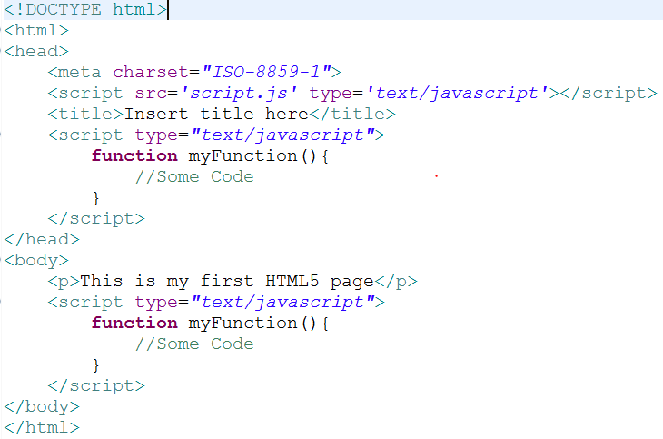
III. JavaScript & jQuery Integrating JavaScript into HTML
Three possibilities to integrate JavaScript into HTML:
As a separate file → refer to it in the head
Within the head
Within the body

Slide 17

III. JavaScript & jQuery Variables
Dynamically typed
Variables defined outside of a function are global
Omitting the keyword var inside a function makes the variable global

Slide 18
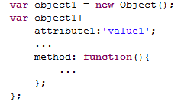

III. JavaScript & jQuery Objects
Creating an object:
Predefined objects: e.g. Date, Math, String, Array, etc.
Using the methods of an object
method of the object Date

Slide 19
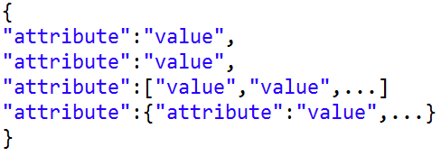
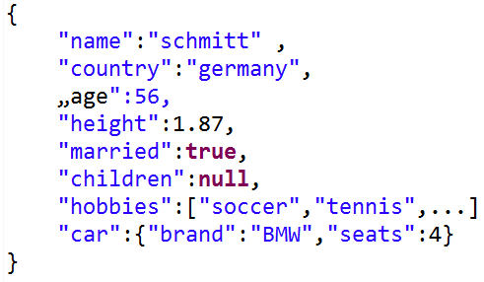
III. JavaScript & jQuery JSON Format
Usage
Transmit data objects in a human-readable fashion
Language-independent format (although derived from javascript objects)
DATA-Types
String
Number
boolean
(JSON) object
Array
Null
Examples
Array, [value,…]
Object

Slide 20
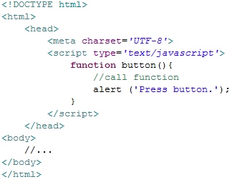
III. JavaScript & jQuery Functions
keyword ‘function‘
function name
curly brackets

Slide 21
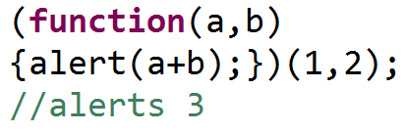
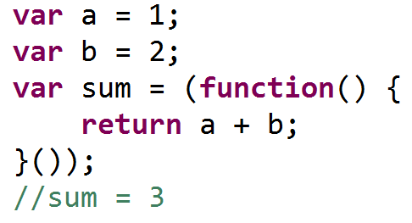
III. JavaScript & jQuery Anonymous functions
Define function without naming it (e.g. when it‘s only used once, or is called right after it has been defined)
Commonly used when function is immediatley executed in programm flow or passed as a parameter (especially in event handling)
Used for variable definition
Used for in-place call

Slide 22


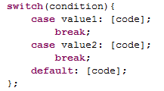
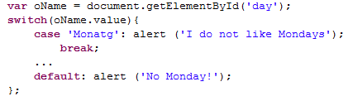




III. JavaScript & jQuery Control structures
If:
Switch:
For:
While:

Slide 23
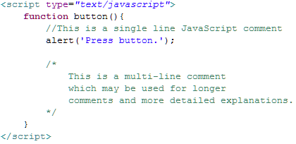
III. JavaScript & jQuery Source code comments
single line comment with //
Multi-line comments using /* and */

Slide 24
III. JavaScript & jQuery Document Object Model (DOM)
root
<body>
Element[0]
parentNode
firstChild
<div>
nextSibling
Element[1]
previousSibling
childNodes[1]
<p>
textNode
parentNode
childNodes[0]
content
lastChild
Element[n]
<…>

Slide 25
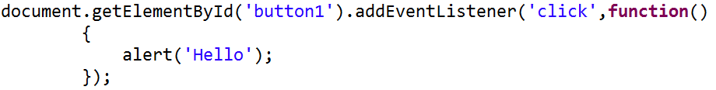
III. JavaScript & jQuery JavaScript event handling
Event Handler: instructions that are executed when an event occurs (e.g. user clicks a button)
Event-handling copes with non-deterministic incidents (uncertainty what user will do, or how long it takes the page to load) without stopping the programm flow (like in the case of polling)
Anonymous function as parameter for click event
Assign anonymous function as action

Slide 26
III. JavaScript & jQuery JavaScript events
onabort: cancellation
onblur: quitting
onchange: change
onclick: click
ondblclick: double click
onerror: error
onfocus: activation
onkeydown: pressing key
onkeypress: pressing key
onkeyup: letting the key go
onload: loading a file
onmousedown: pressing mouse
onmousemove: moving mouse
onmouseout: letting the element go
onmouseover: touching the element
onmouseup: letting mouse go
onreset: resetting the formular
onselect: selecting text
onsubmit: submitting the formular
onunload: leaving the file

Slide 27
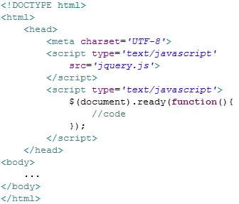
III. JavaScript & jQuery jQuery selectors
Factory function $(): access to objects
Ready function: the function is being executed after loading the page
CSS | jQuery
element {…} | $(‘element‘);
#id | $(‘#id‘);
.class | $(‘.class‘);

Slide 28
III. JavaScript & jQuery jQuery events
.bind: binding the handler to the event
.on: binding the handler to the event
.blur: when an element loses the focus
.click: click
.dbclick: double click
.hover: moving the mouse pointer over an element
.mousemove: moving the mouse pointer inside an element
.keypress: pressing a key on the keyboard
.keyup: letting the key go
.change: change of the formular field

Slide 29
III. JavaScript & jQuery jQuery DOM manipulation
.after(): add the content behind the element
.append(): add the content at the end of the element
.appendTo(): add the content at the end of the element
.insertAfter(): attach the content to the element
.insertBefore(): attach the content before the element
.prepend(): attach the content at the beginning of the element
.prependTo(): attach the content at the beginning of the element
.remove(): remove the element
.wrap(): use the HTML structure
.addClass(): add the class to the elements
.removeClass(): remove the class
.css(): set the css attribute

Slide 30
Now you know the fundamentals of JavaScript and jQuery.
To consolidate your knowledge, you can do task 4 of the HTML5, CSS & JavaScript exercise.

Slide 31
Check your knowledge

Slide 32
Check your knowledge
A web browser with internet connection is needed to show a rendered HTML5 page
□ True □ False
Document type declaration, header section and body are completely separated in HTML5
□ True □ False
Compare text elements, tables, and forms. For which purpose should they be mainly used?
If all three integration possibilities for CSS define a different background color for the same element, which style definition is dominant?
□ Declaration in separate file
□ Direct declaration in header section
□ Inline declaration
Why is it preferable to use jQuery instead of native JavaScript?

Slide 33
Solution

Slide 34
Solution
A web browser with internet connection is needed to show a rendered HTML5 page
□ True ☒ False
Document type declaration, header section and body are completely separated in HTML5
☒ True □ False
Compare text elements, tables, and forms. For which purpose should they be mainly used?
See section HTML5
If all three integration possibilities for CSS define a different background color for the same element, which style definition is dominant?
□ Declaration in separate file
□ Direct declaration in header section
☒ Inline declaration
Why is it preferable to use jQuery instead of native JavaScript?
See section JavaScript & jQuery

Slide 35
References
Antolovic, M.: (2016): Einführung in SAPUI5, SAP PRESS 2016

